Slide 1
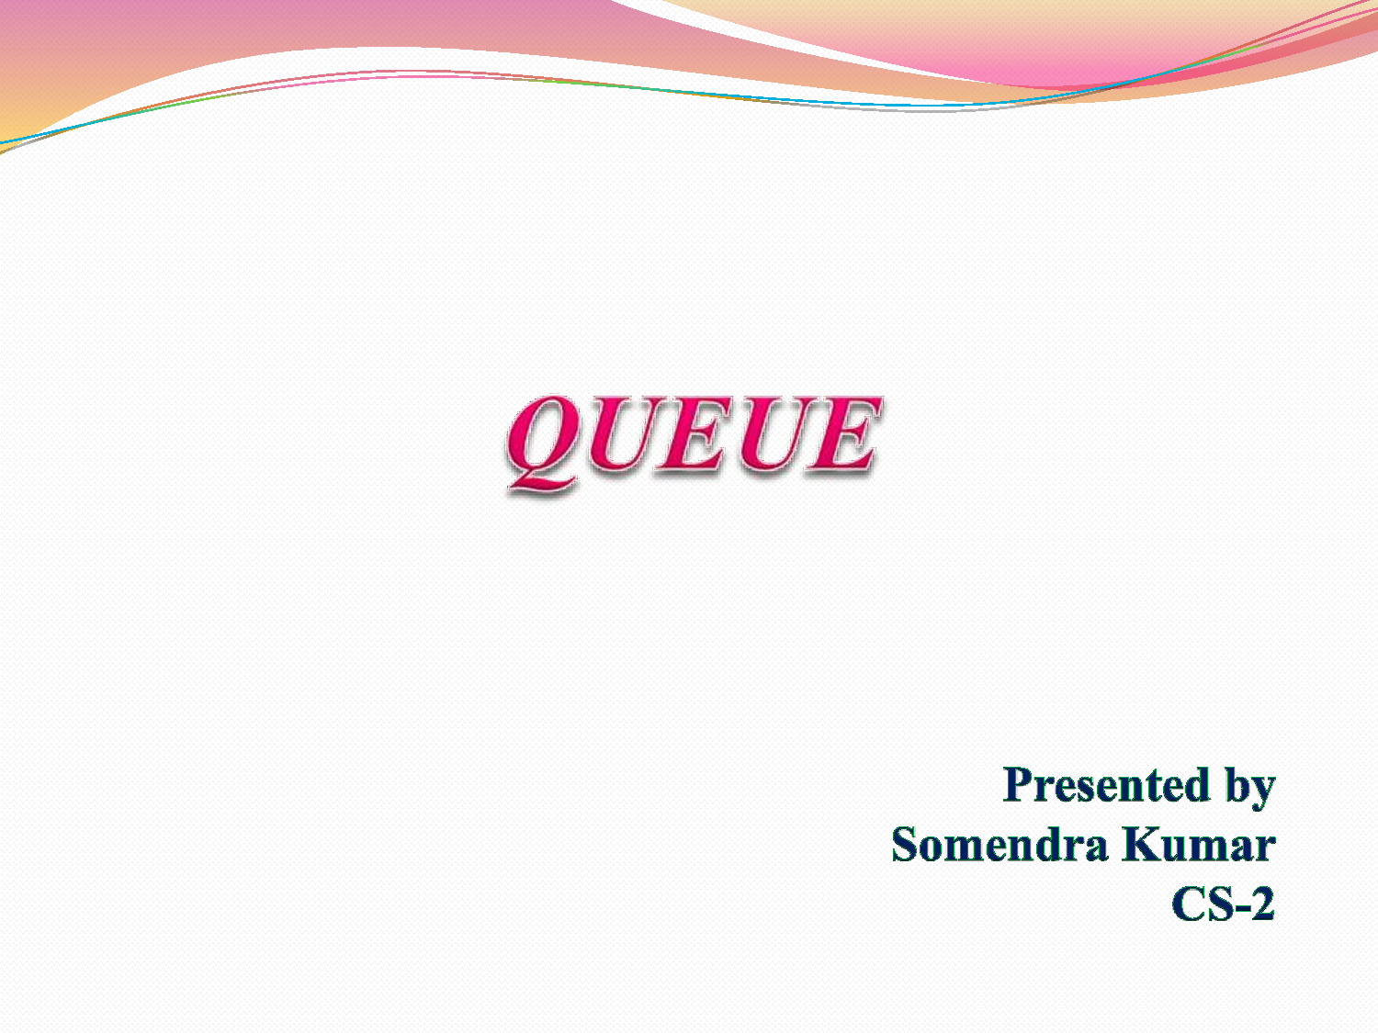

Slide 2
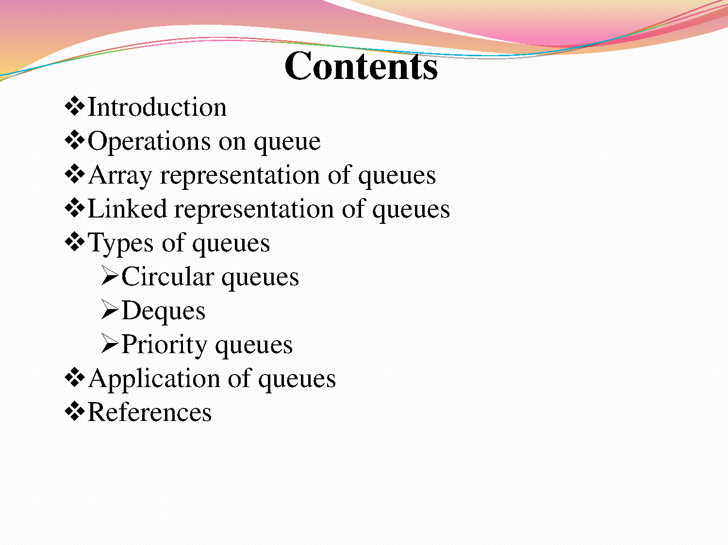

Slide 3
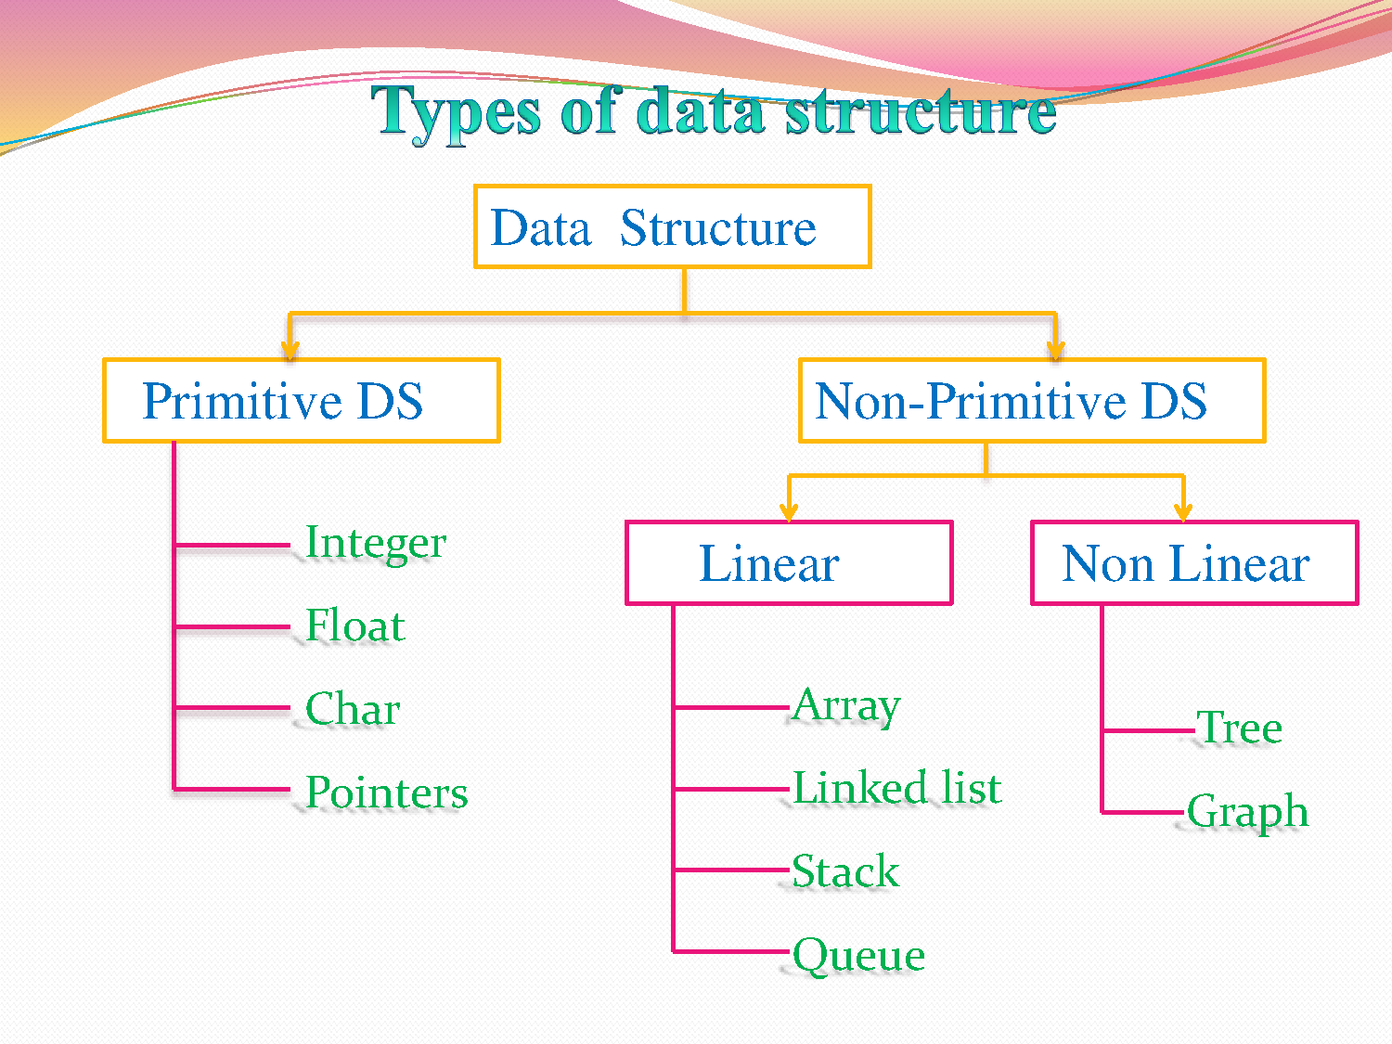

Slide 4
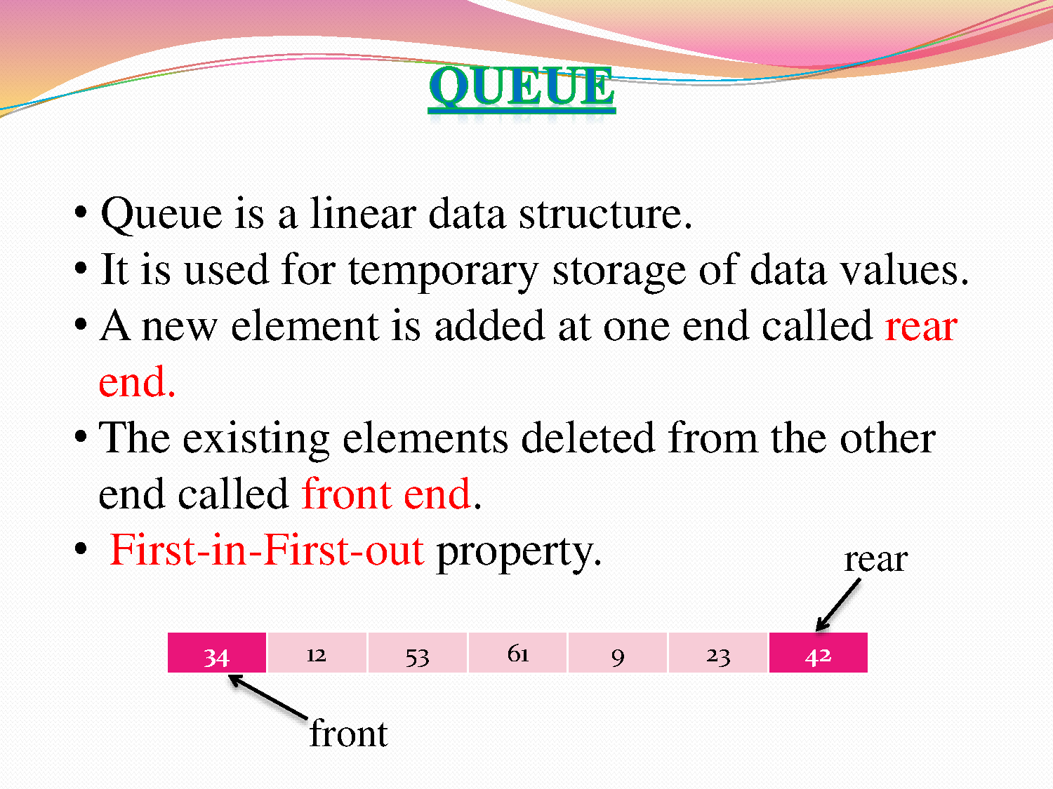

Slide 5
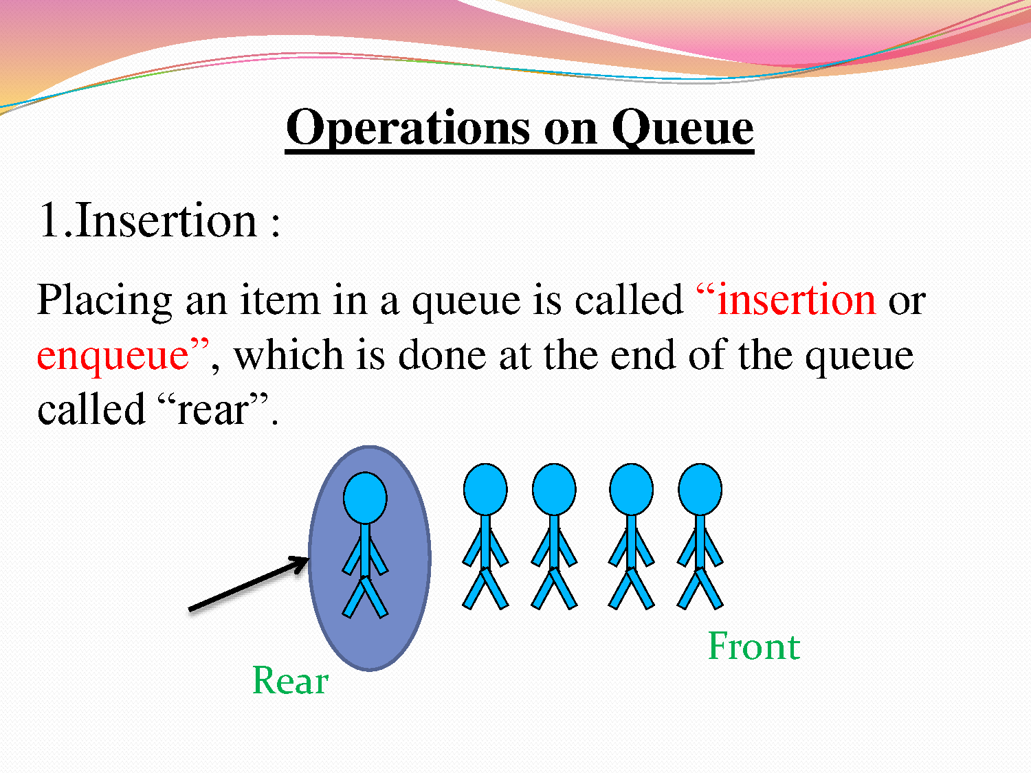

Slide 6
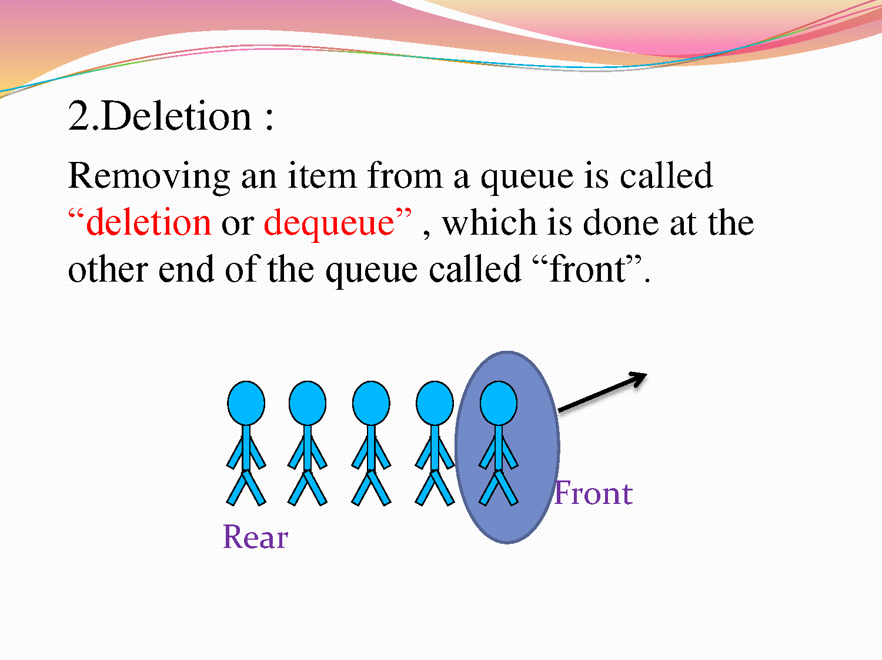

Slide 7
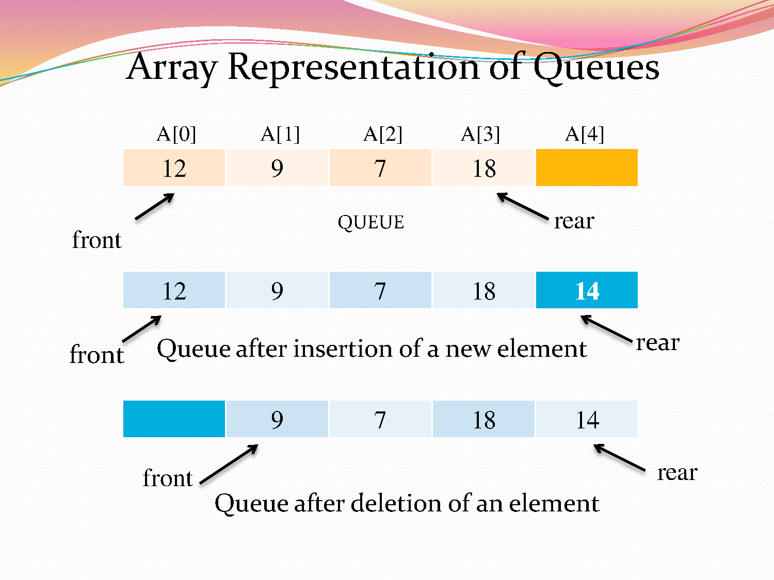

Slide 8
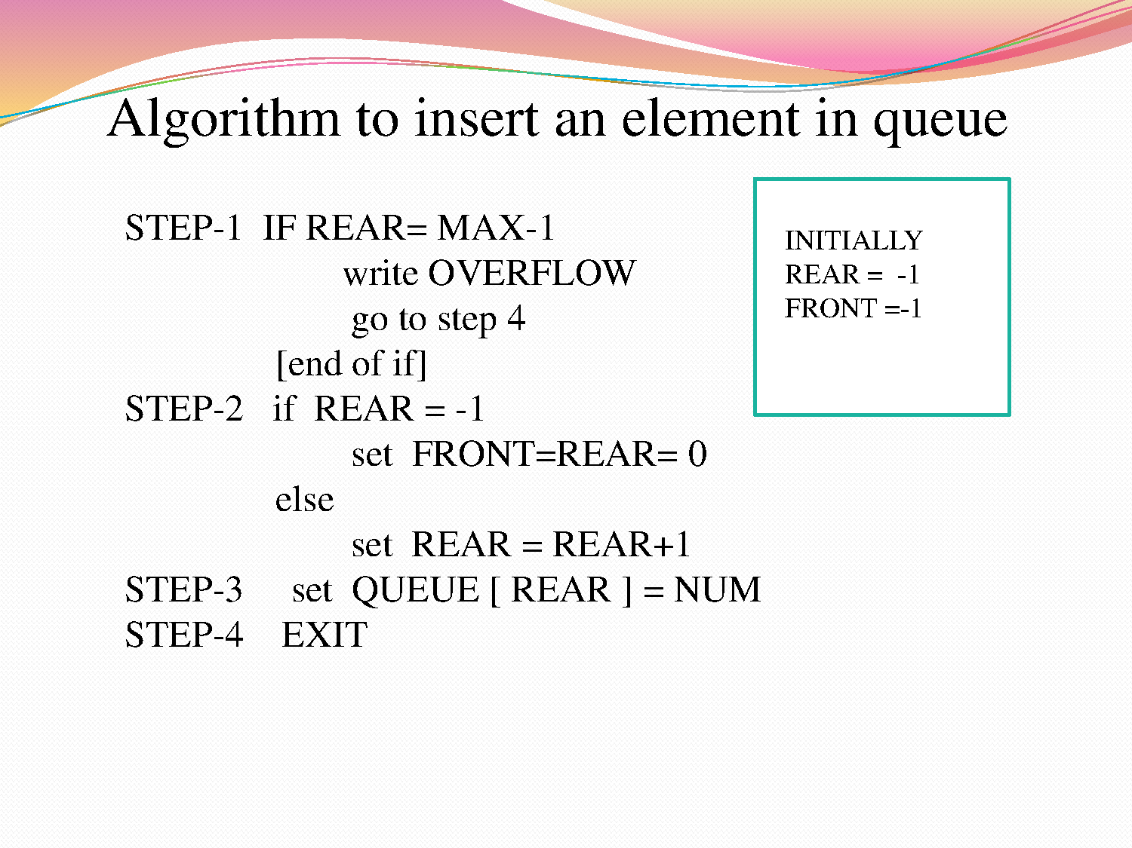

Slide 9
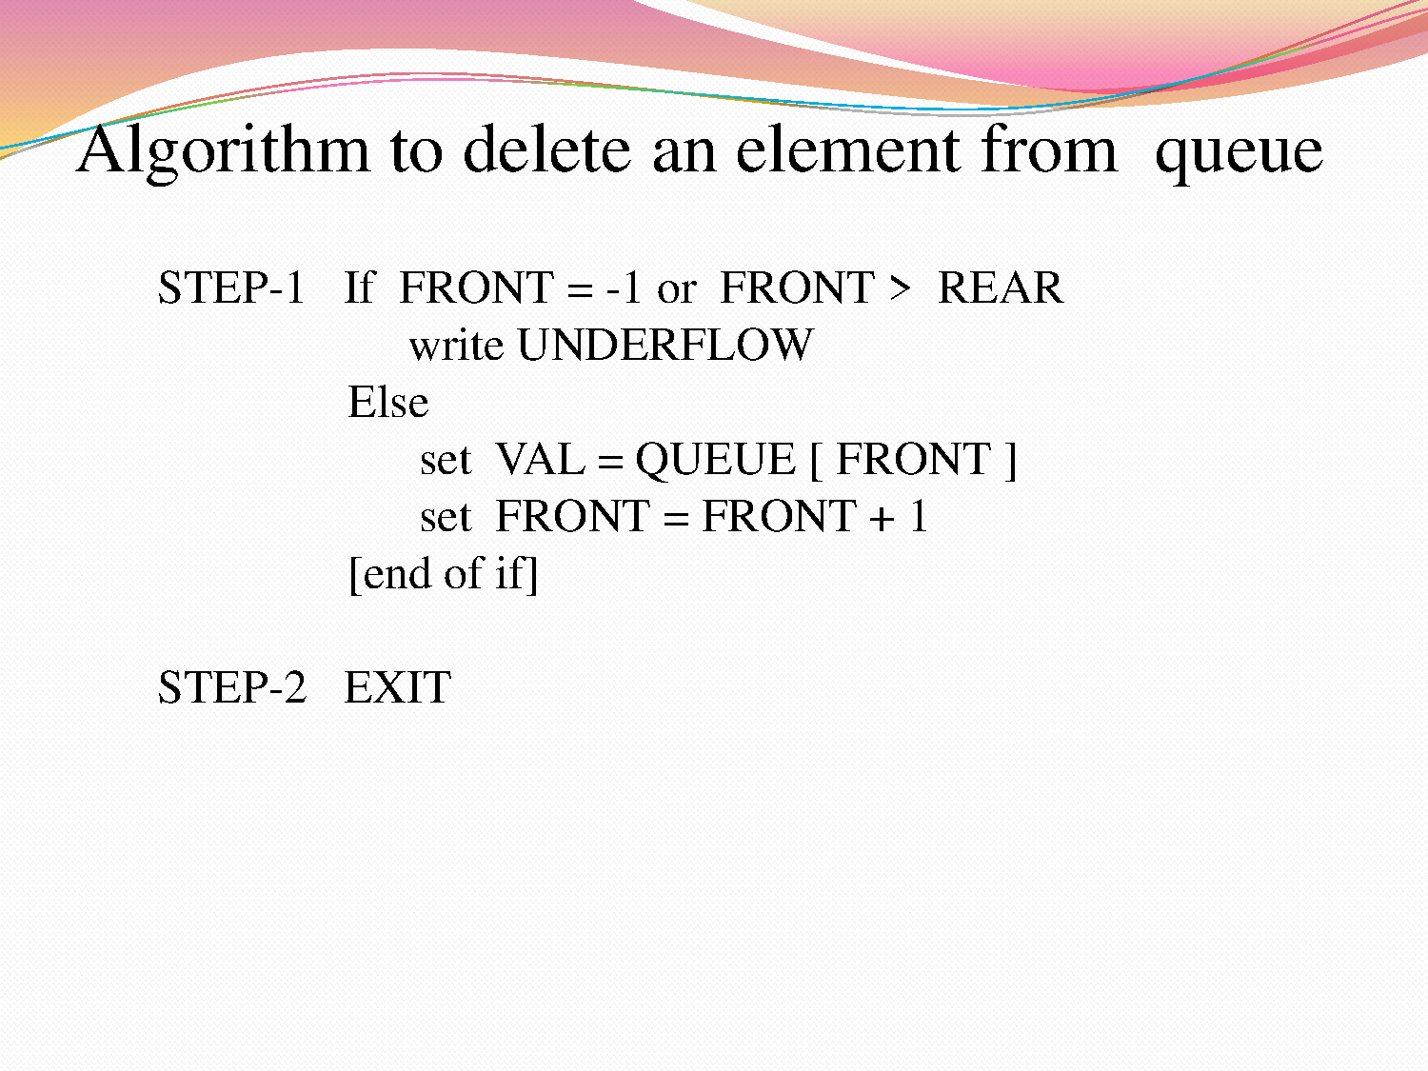


Slide 10
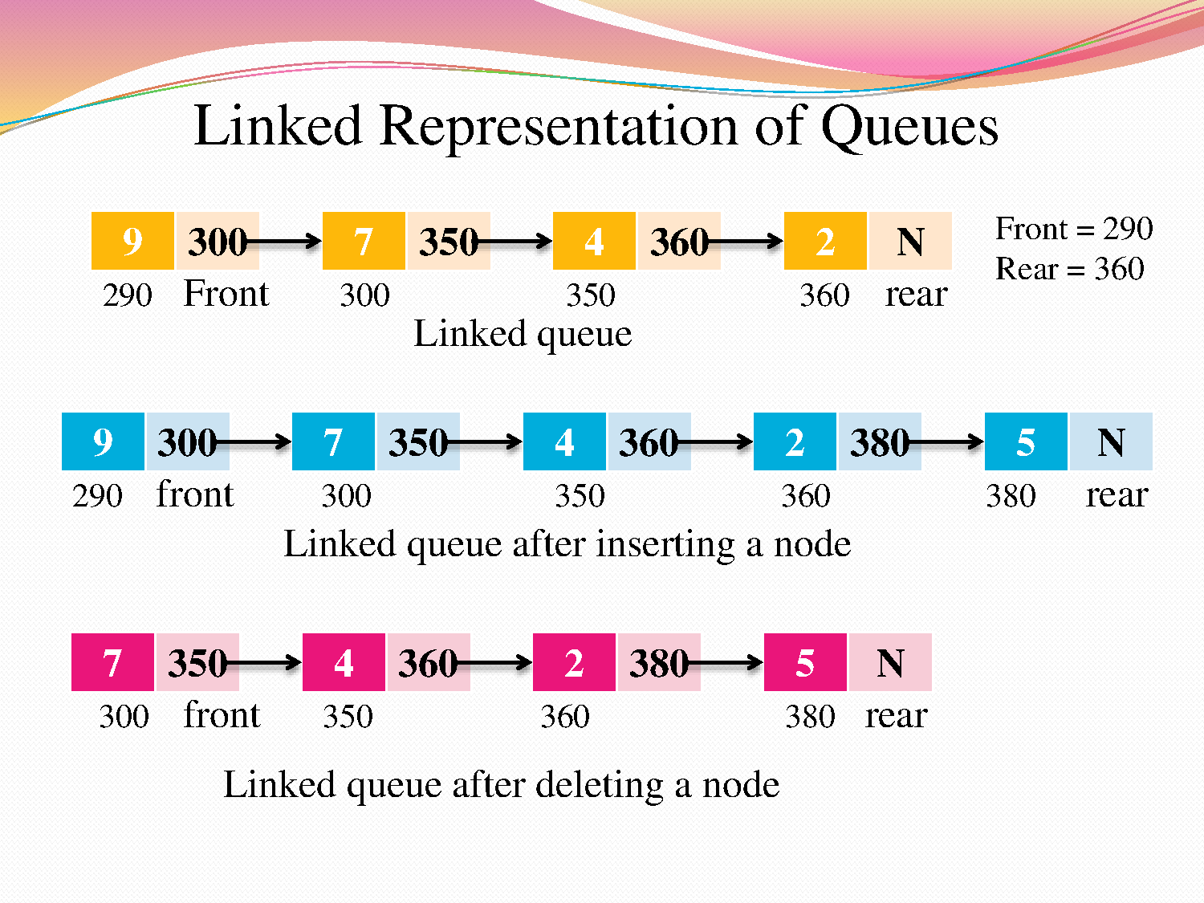

Slide 11
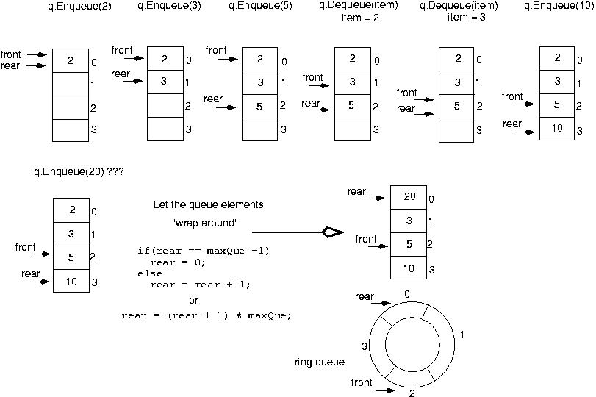
BUT in case of circular queue, 20 will be inserted at index 0.
In case of Simple Queue, its an Overflow condition

Slide 12
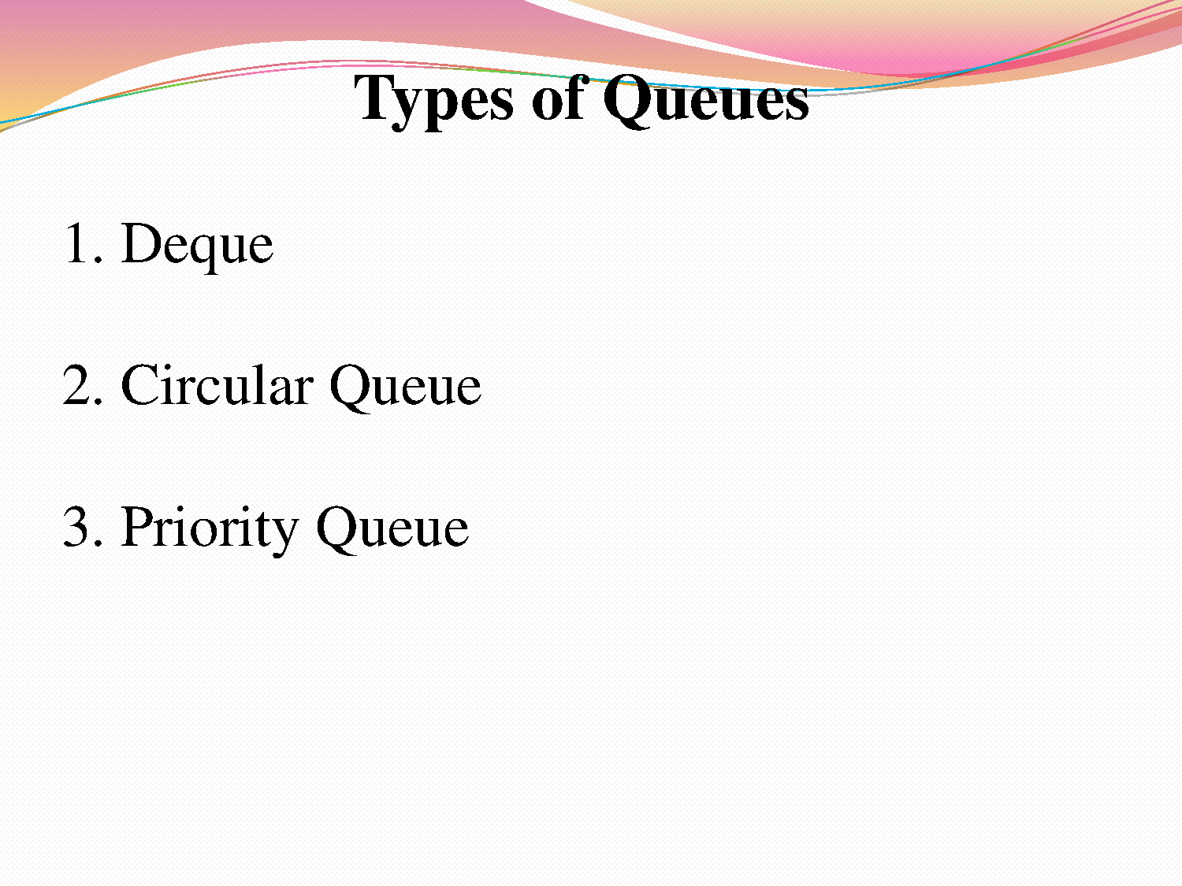

Slide 13
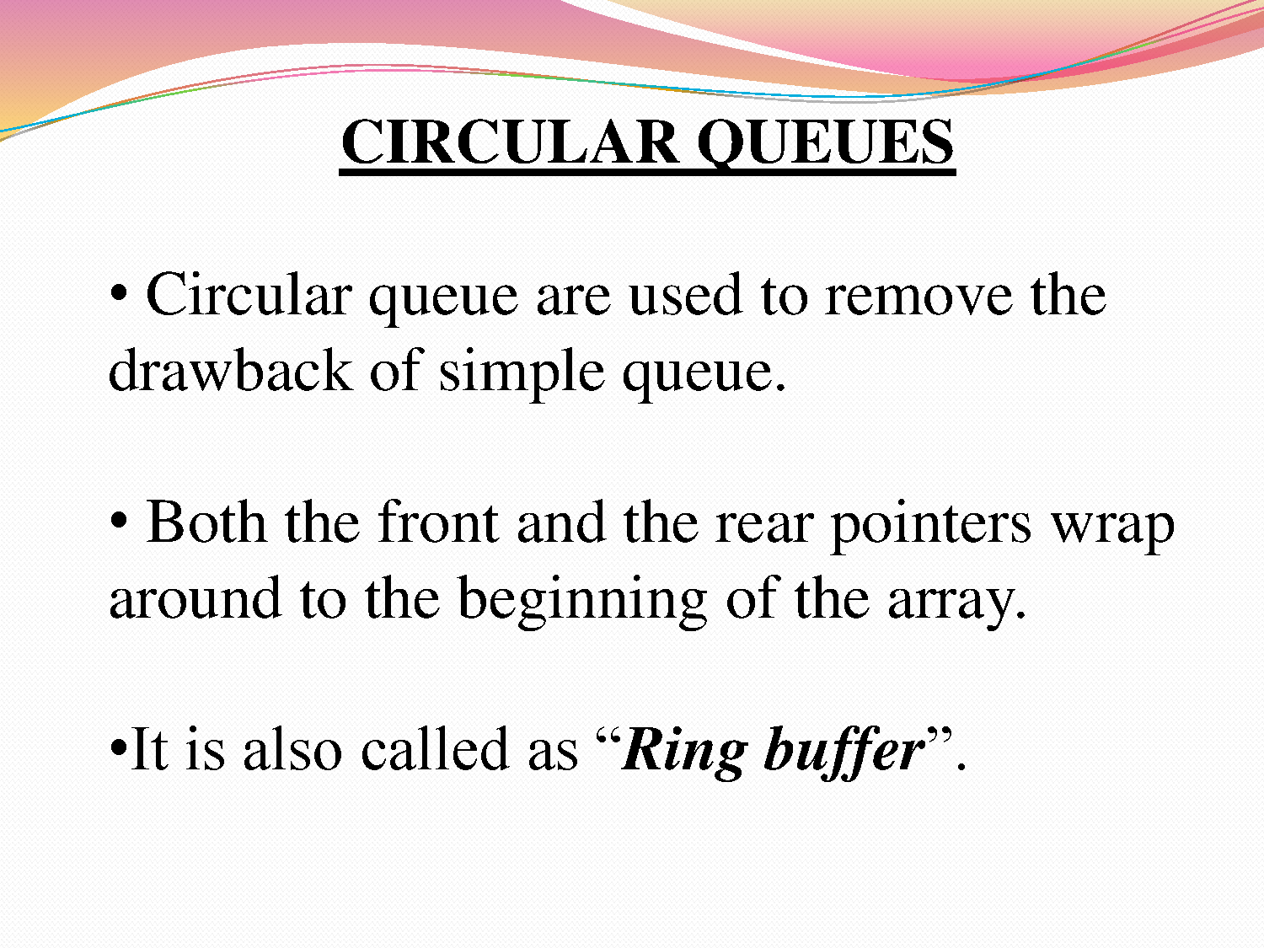

Slide 14
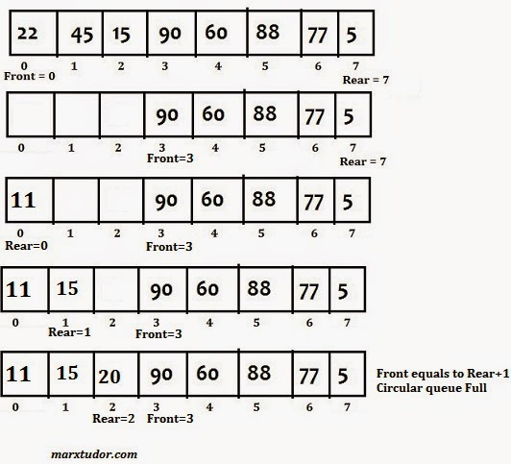

Slide 15
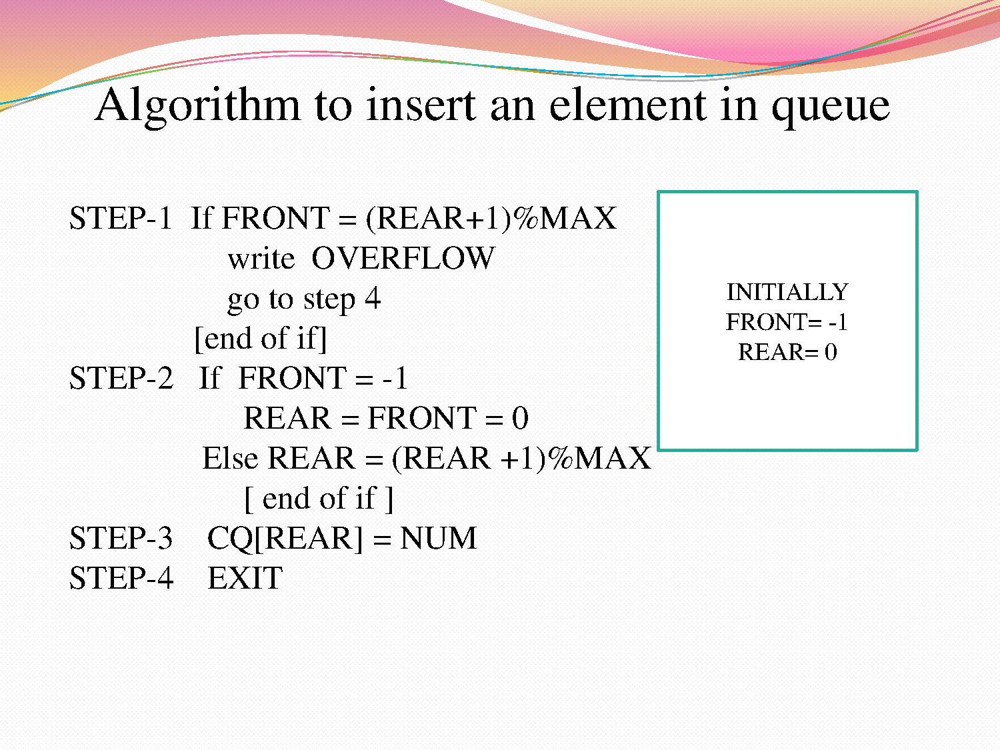

Slide 16
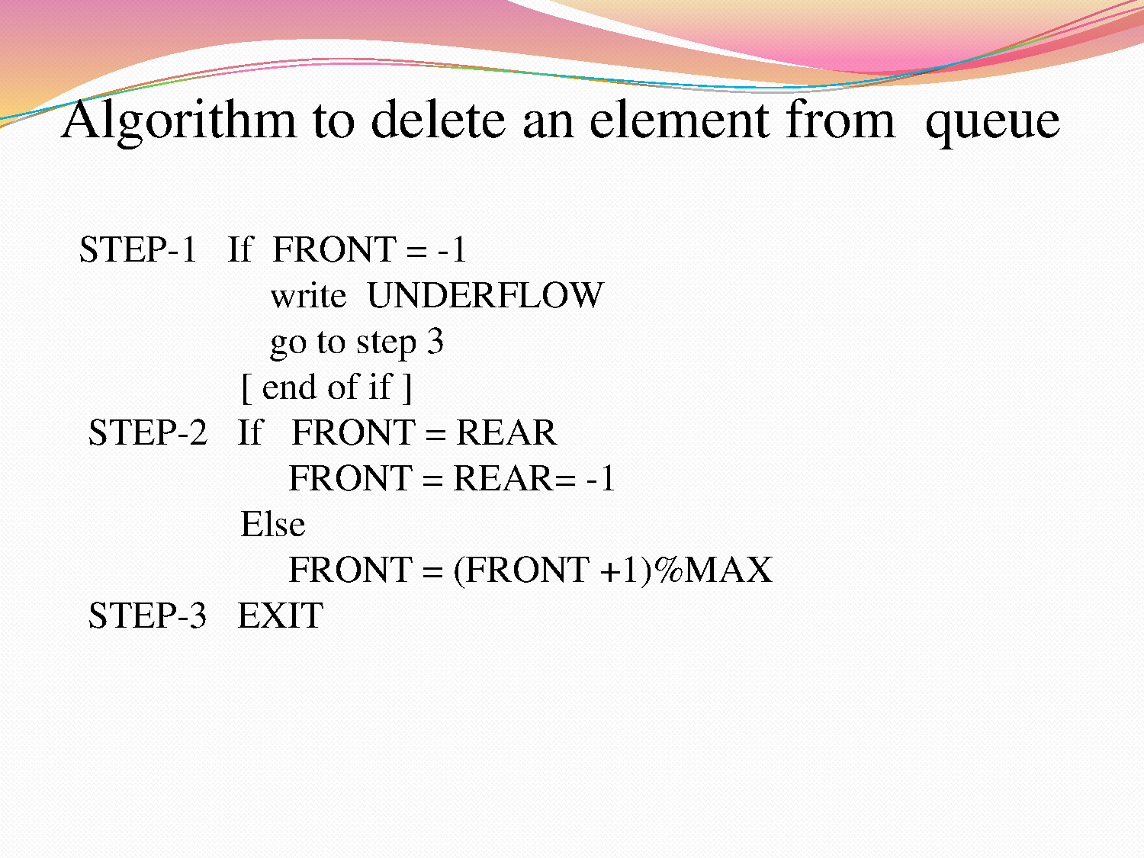

Slide 17
Practice Questions

Slide 18
A circular queue is implemented using an array of size 10. The array index starts with 0, front is 6, and rear is 9. The insertion of next element takes place at the array index.
1
0
7
6

Slide 19
Let the following circular queue can accommodate maximum six elements with the following data front = 2 rear = 4 queue = ____; L, M, N, ___, ___
What will happen after Enqueue (O) operation takes place?
a) front = 2 rear = 5 c) front = 3 rear = 4 queue = ____; L, M, N, O, ___ queue = ____; L, M, N, O, ___
b) front = 3 rear = 5 d) front = 2 rear = 4 queue = L, M, N, O, ___ queue = L, M, N, O, ___

Slide 20
Priority Queue
Priority Queue is an extension of with following properties:
Every item has a priority associated with it.
An element with high priority is dequeued before an element with low priority.
If two elements have the same priority, they are served according to their order in the queue.

Slide 21
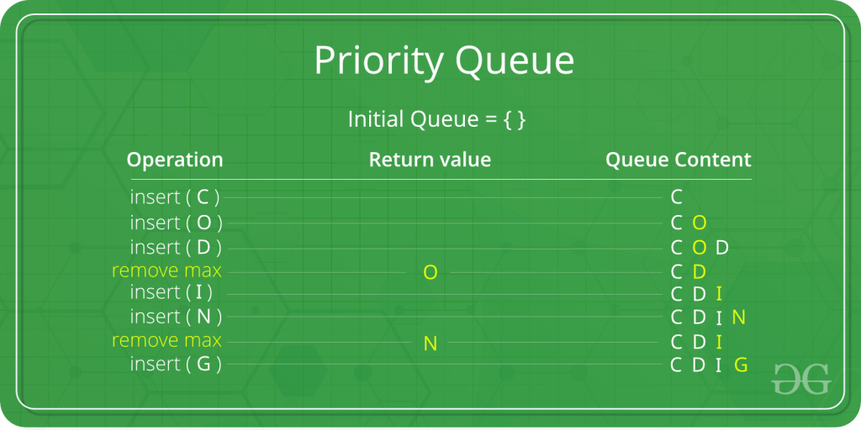
Priority Queue
In the below priority queue, element with maximum ASCII value will have the highest priority.

Slide 22
Applications of Priority Queue:
CPU Scheduling
2) Graph algorithms like Dijkstra’s shortest path algorithm, Prim’s Minimum Spanning Tree, etc
3) All queue applications where priority is involved.

Slide 23
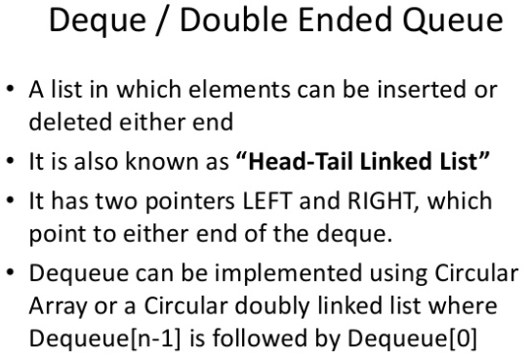
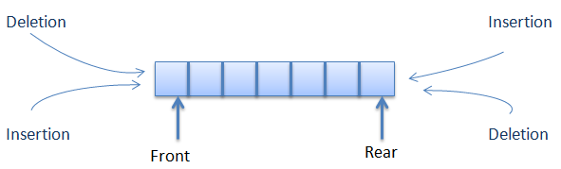
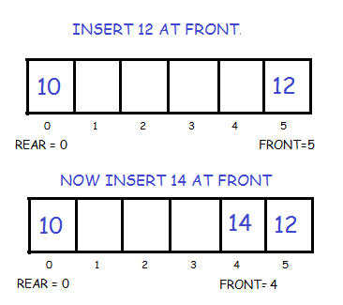

Slide 24
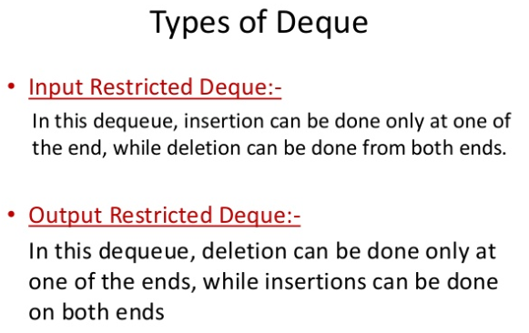

Slide 25
THANK YOU

